Slide 1

LOL Diamond Ranked Game Outcome Prediction
Ruiming Yu, Xin Chen

Slide 2
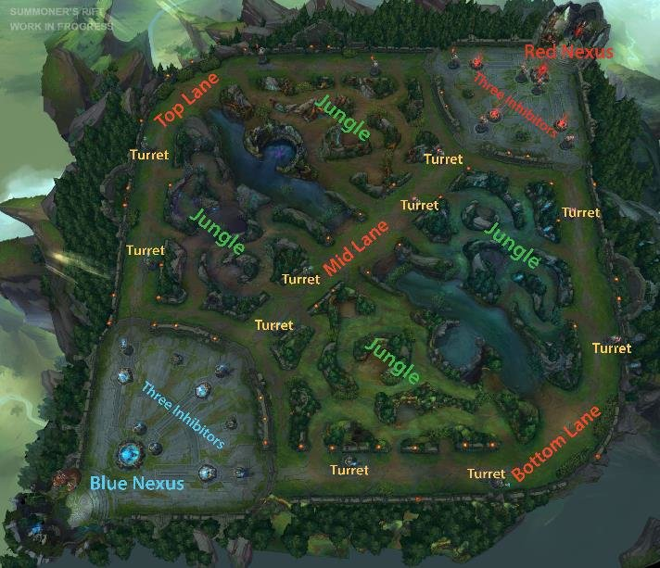
Introduction
League of Legends (LOL): multiplayer online battle arena (MOBA) video game
Two teams: Blue side against Red side
Goal: Five champions face off to destroy the enemy’s Nexus
Champions build their powers by: items, levels, gold, and experiences
Through destroying turrets, killing minions, jungle minions, dragons, rift Herald and enemy champion
Average match: 20 to 40 minutes
Problem: Predict the winning team of the game by
using data from the first 10 minutes and applying
multiple classification models
Why predicting the outcome of a match?

Slide 3
Data Preparation
Basic information and introduction
Missing Data
Collinearity
Weak correlation with response
Manipulation of the response
Training, test data split
Cross-validation set

Slide 4
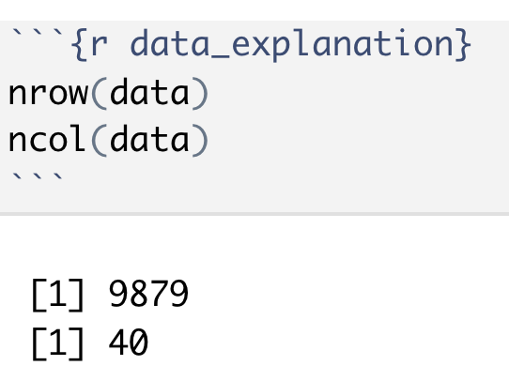
Data Preparation: basic information
There are 9879 observations and 40 columns in the data set.
The response is categorical (binary), and other variables are continuous.

Slide 5
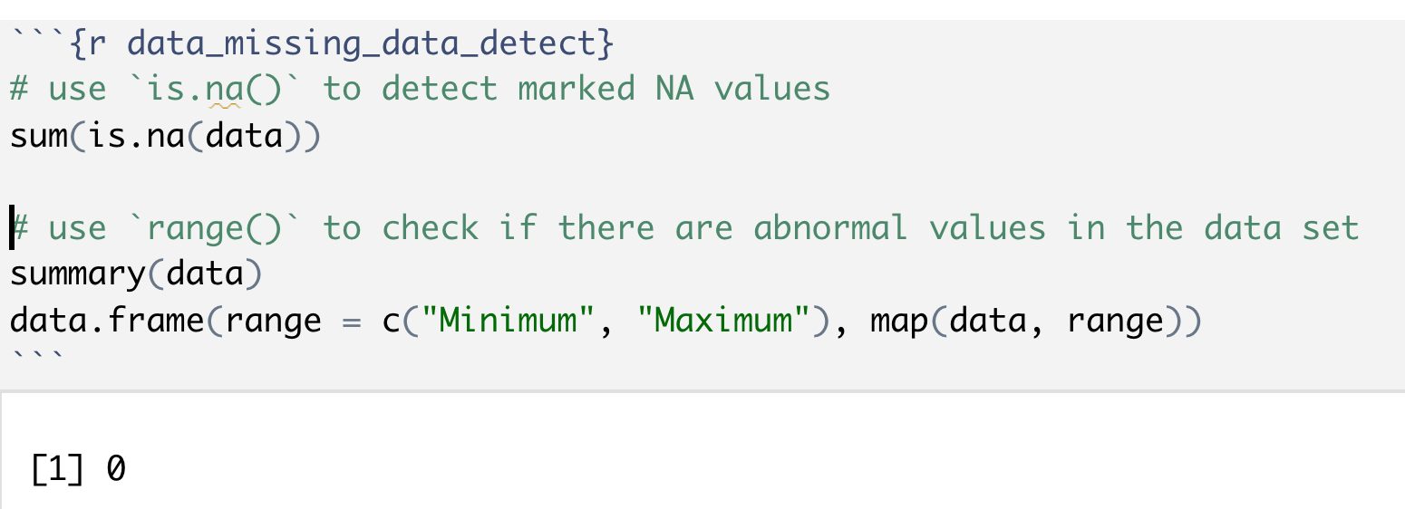
Data Preparation: cleaning for missing data
Methods:
Use `is.na()`, `summary()` and `range()` to check for potential missing datas
Results:
No obvious missing data

Slide 6
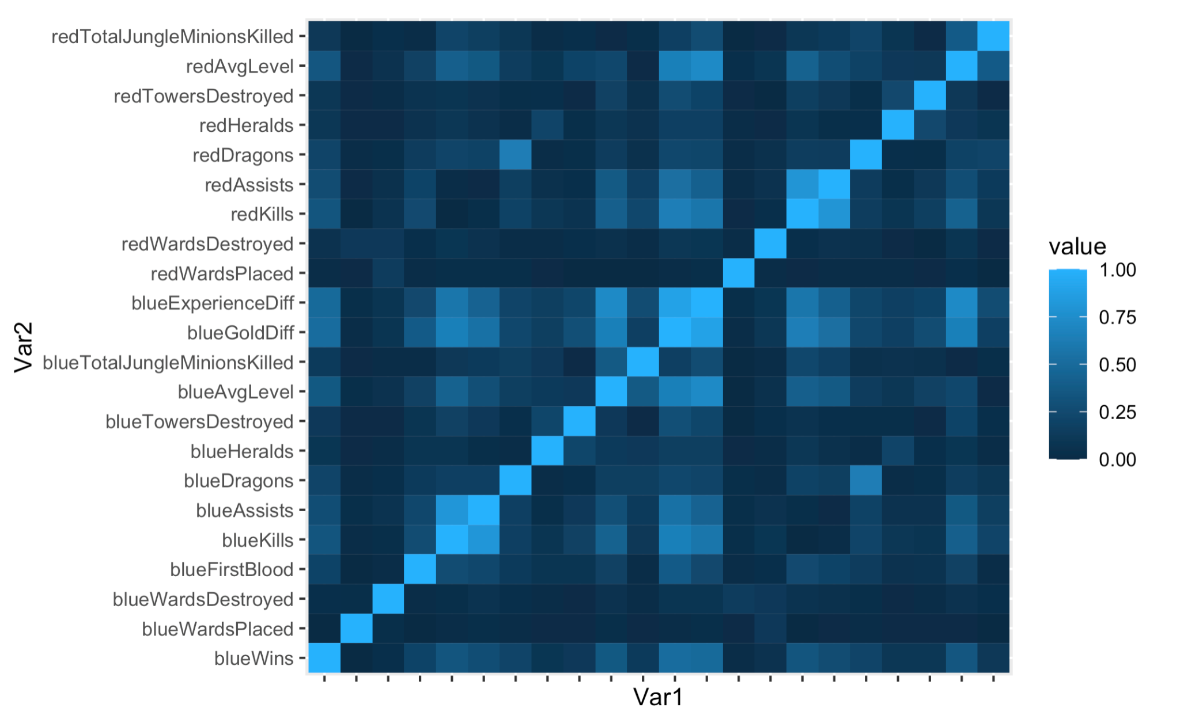
Data Preparation: cleaning for weak correlation
Methods:
Plot heatmap and use `cor()` to check correlation with the response
Results:
Get rid of variables that has a
pearson_coef < 0.05 correlation

Slide 7
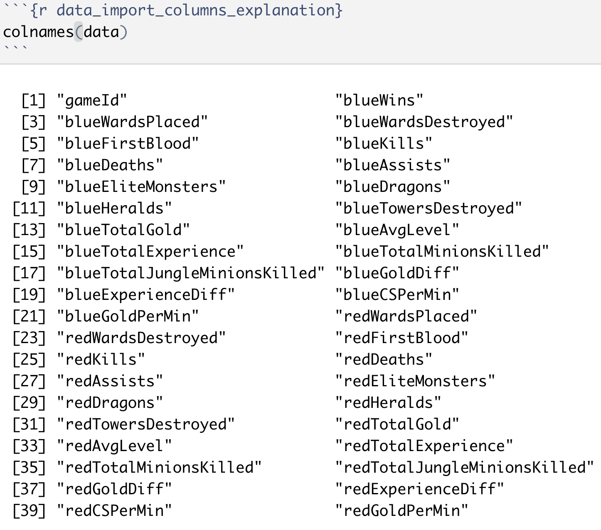
Data Preparation: cleaning for strong collinearity
Problems:
Some of the variables are completely correlated
Like “redKills” and “blueDeaths”
Solution:
Leave one in each pair to prevent collinearity

Slide 8
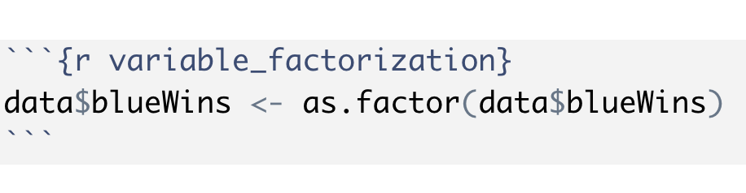
Data Preparation: manipulation of the response
Methods:
Change response to factor to avoid errors in model fitting

Slide 9
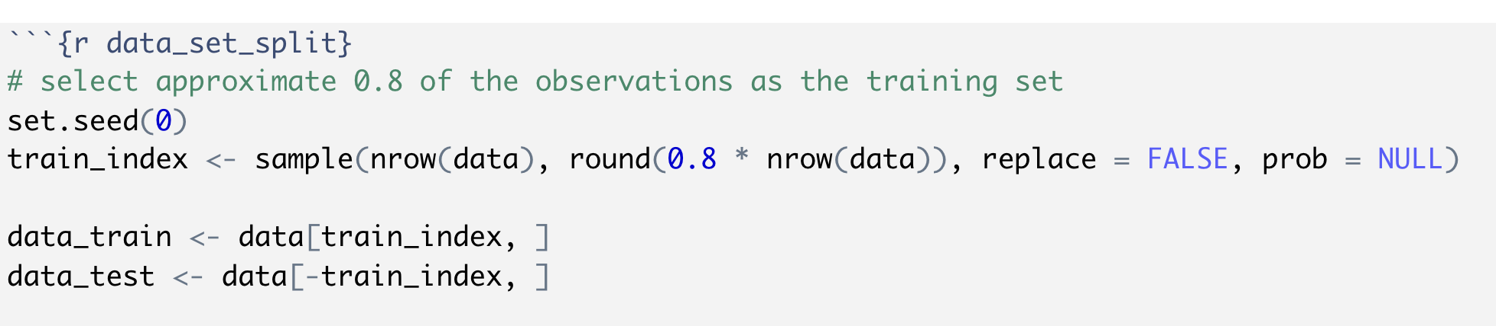
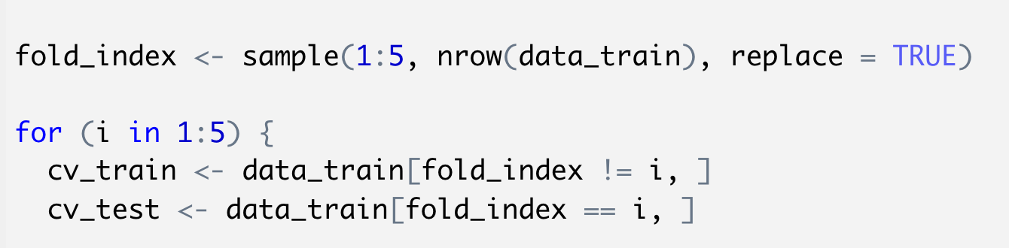
Data Preparation: training, test and cv data sets
Results:
Split the data set into training and test set
train : test = 8 : 2
Create cross-validation set
K = 5

Slide 10
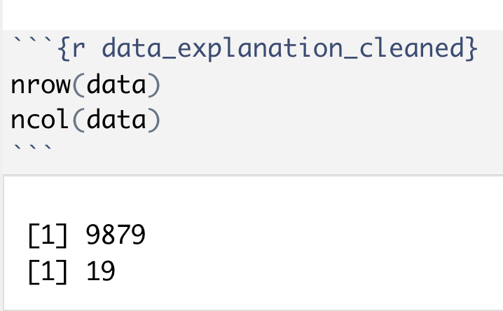
Data Preparation: conclusion
Results:
19 variables are selected. 1 response and 18 predictors.
Training, test sets created.

Slide 11
Methods and algorithms
Evaluation Metrics
Naive Model
Various Machine Learning Models

Slide 12
Methods and algorithms: Metrics
Focus on training and test errors
Evaluate the ROC and AUC scores

Slide 13
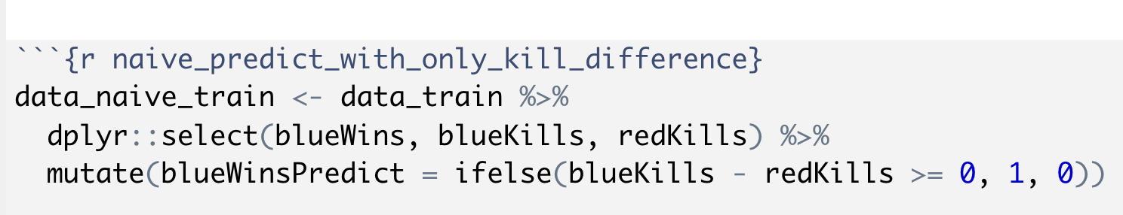
Methods and algorithms: Naive Model
Predict winner by only two variables
The most straightforward methods for many players
Use this naive model for baseline evaluation

Slide 14
Methods and algorithms: Machine learning models
Logistic
LDA
QDA
KNN
Decision Tree
Random Forest
Parameters tuning
Training error
Test error
ROC curve
AUC score
Cross-validation
Final Model

Slide 15
Methods and algorithms: conclusion
Created naive model for baseline
Trained and cross-validated different classification models
Computed training, test errors, and ROC curves for evaluation

Slide 16
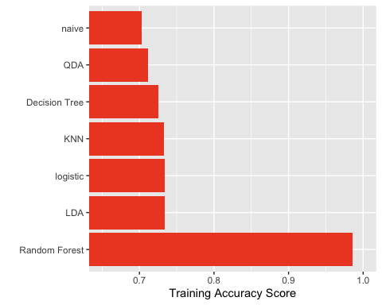
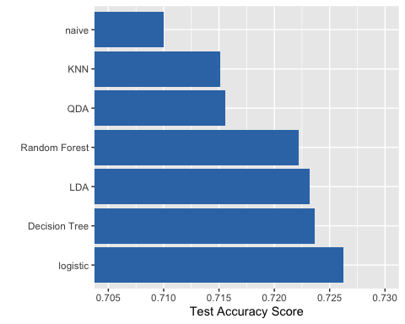
Results: Training and Test Errors

Slide 17
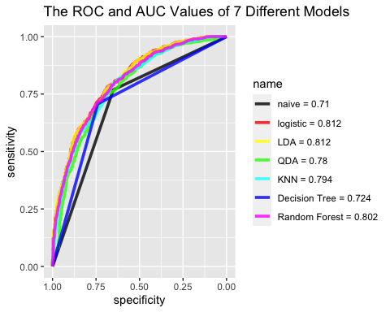
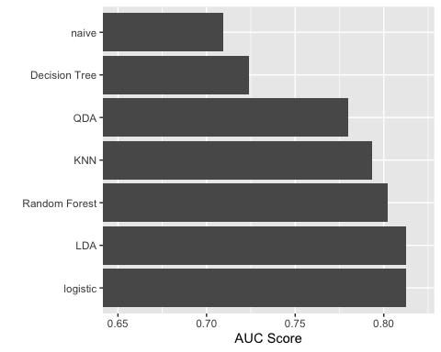
Results: ROC

Slide 18
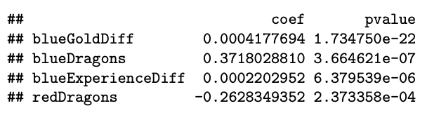
Conclusion
Best Model: Logistic Regression
Further analyses
Other factors like champion selection are not included
The first 10 minutes are not decisive
……

Slide 19


